Slide 1
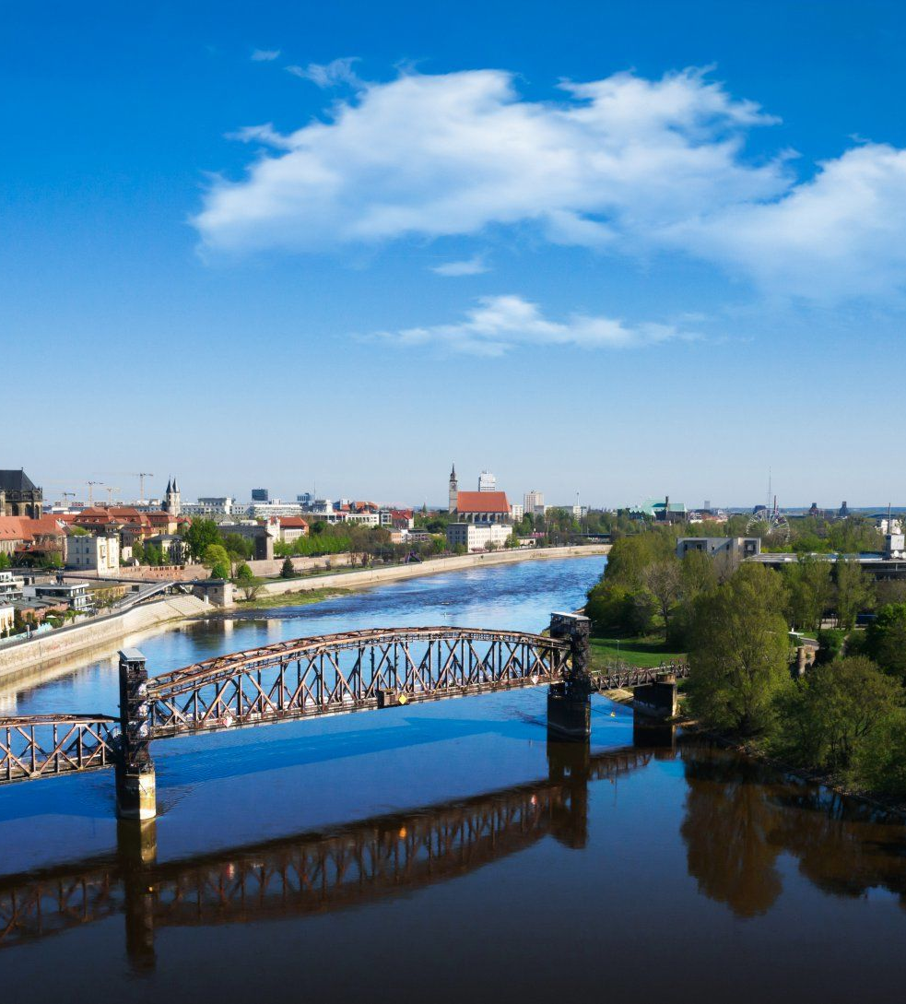
Simulation Project – Team Tetrahedron
Milestone #4 - Data Analysis
Image source: https://cdn.ottopix.de/wp-content/uploads/2019/04/Magdeburg-Panorama-%C3%BCber-der-Hubbr%C3%BCcke.jpg

Slide 2
Agenda
Simulation Project - Team D
Milestone #1 - Team
01
02
Data Analysis
Difficulties
Input data used and output values calculated.
An overview about the difficulties faced.
03
04
Quality of data
Assumptions
An overview of the accuracy and validity of the data.
A brief about the assumptions made.

Slide 3
01
Data Analysis
Estimating the underlying distributions function and testing the hypothesis for the inferences.

Slide 4

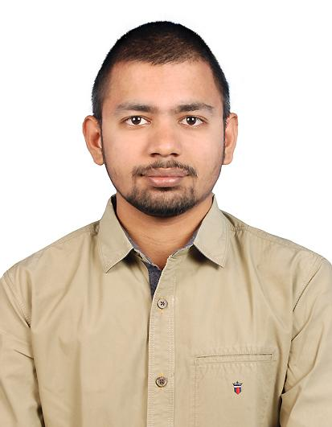

The team
Simulation Project - Team D
Milestone #1 - Team
Lauro Fialho Müller
Team leader
M. Sc. Digital Engineering
Personal goals:
Improve team working skills.
Learn how to handle project challenges.
Chandan Radhakrishna
Conceptual Model
M. Sc. Data and Knowledge Engineering
Personal goals:
Improve my time management skills.
Learn to work in a team.
Raghava Vinaykanth Mushunuri
Input Data Analyst
M. Sc. Digital Engineering
Personal goals:
Work well by contributing to the team objectives.
Acquiring knowledge through real life project.

Slide 5
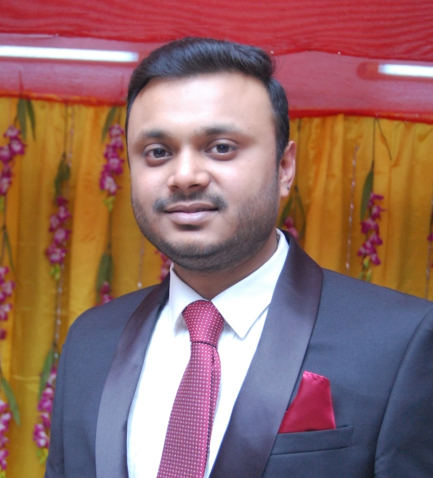
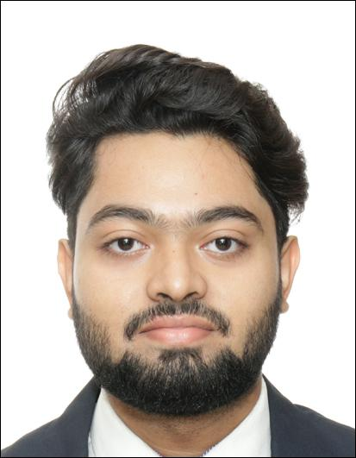

The team
Simulation Project - Team D
Milestone #1 - Team
Kavya Vajja
Chief Software Architect
M. Sc. Digital Engineering
Personal goals:
Commitment to team’s objectives.
Apply knowledge in practice.
Arnab Das
Experiment Designer
M. Sc. Digital Engineering
Personal goals:
Apply concepts to real life project.
Enhance interpersonal skills.
Anjan Chatterjee
Validation and Quality Control
M. Sc. Digital Engineering
Personal goals:
Contribute in every team role.
Improve technical skills on simulation.

Slide 6
02
The project
Simulation Project - Team D
Milestone #1 - Team
An overview of the project’s characteristics

Slide 7
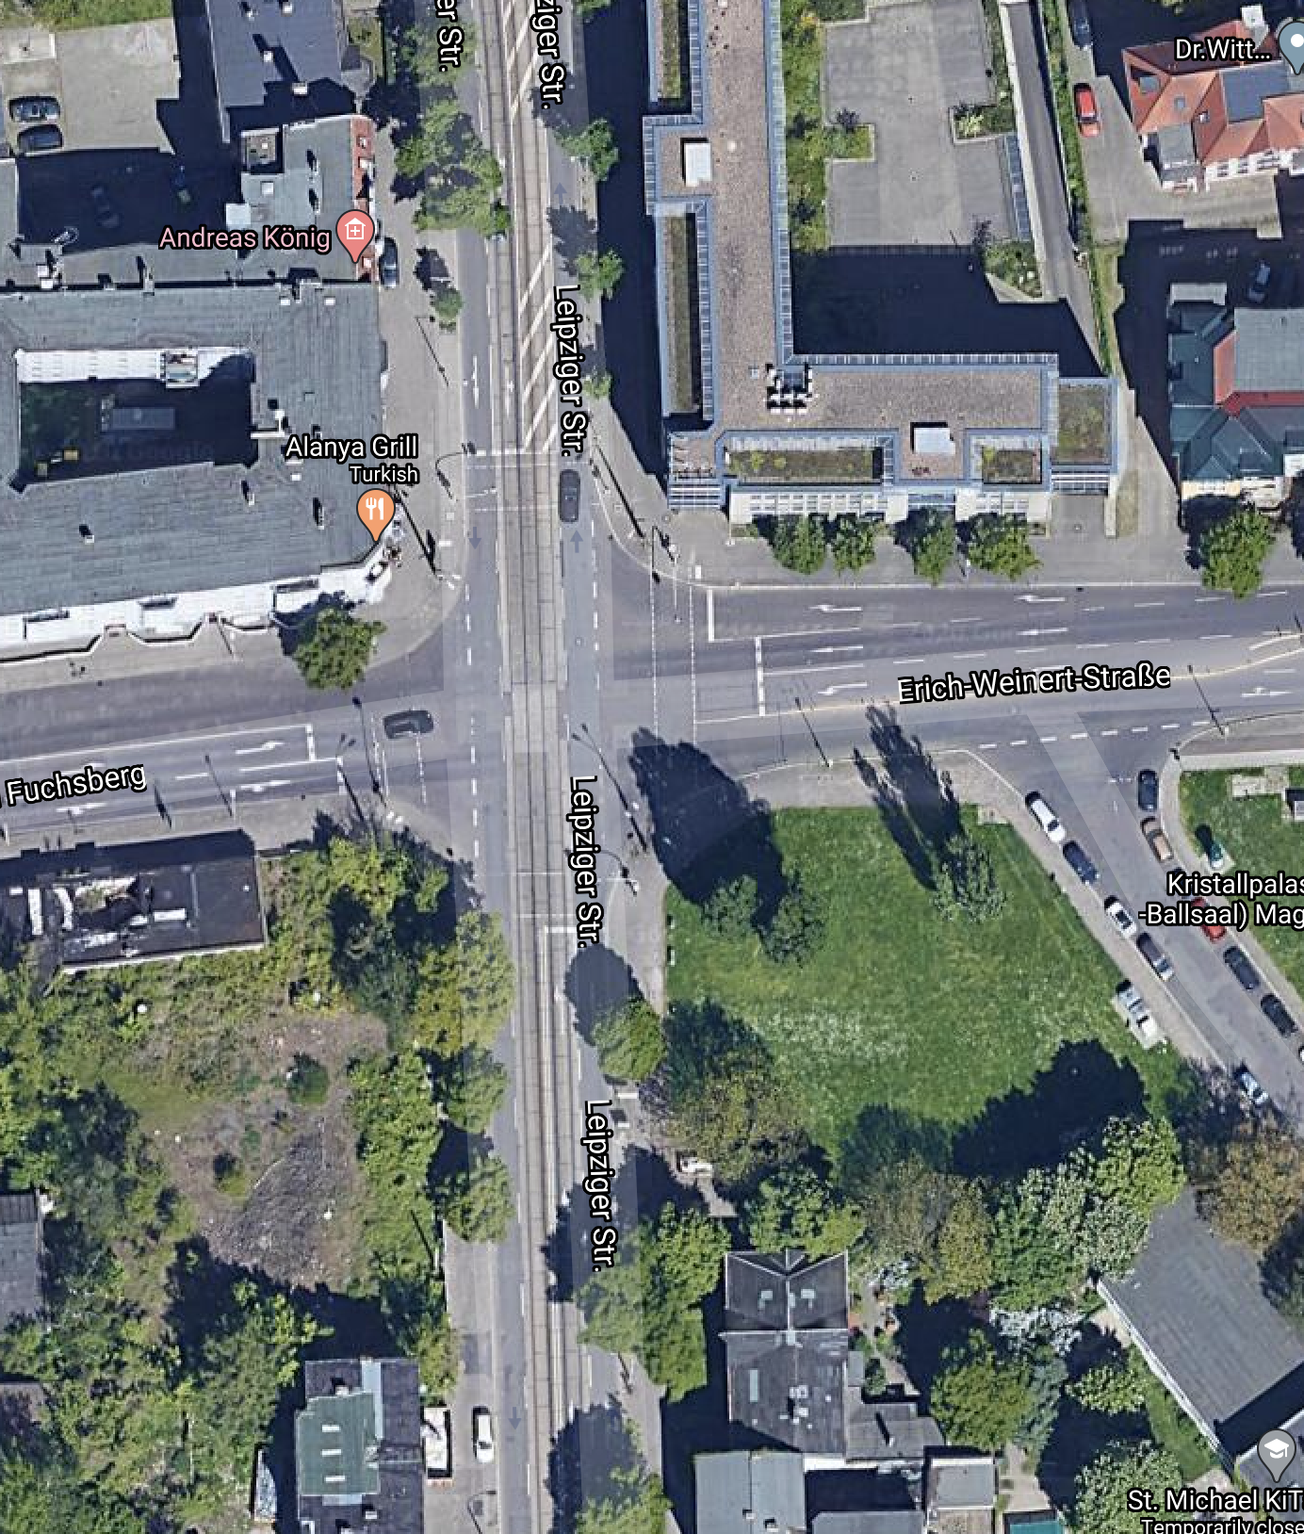
The street intersection
Simulation Project - Team D
Milestone #1 - Team
01
Seemingly heavier traffic on the south part of Leipziger str.
02
Pedestrian crossings in all four sides of the intersection.
03
Exclusive lane for right turns in one of the roads (turning from Erich-Weinert-Straße into Leipziger str.)

Slide 8
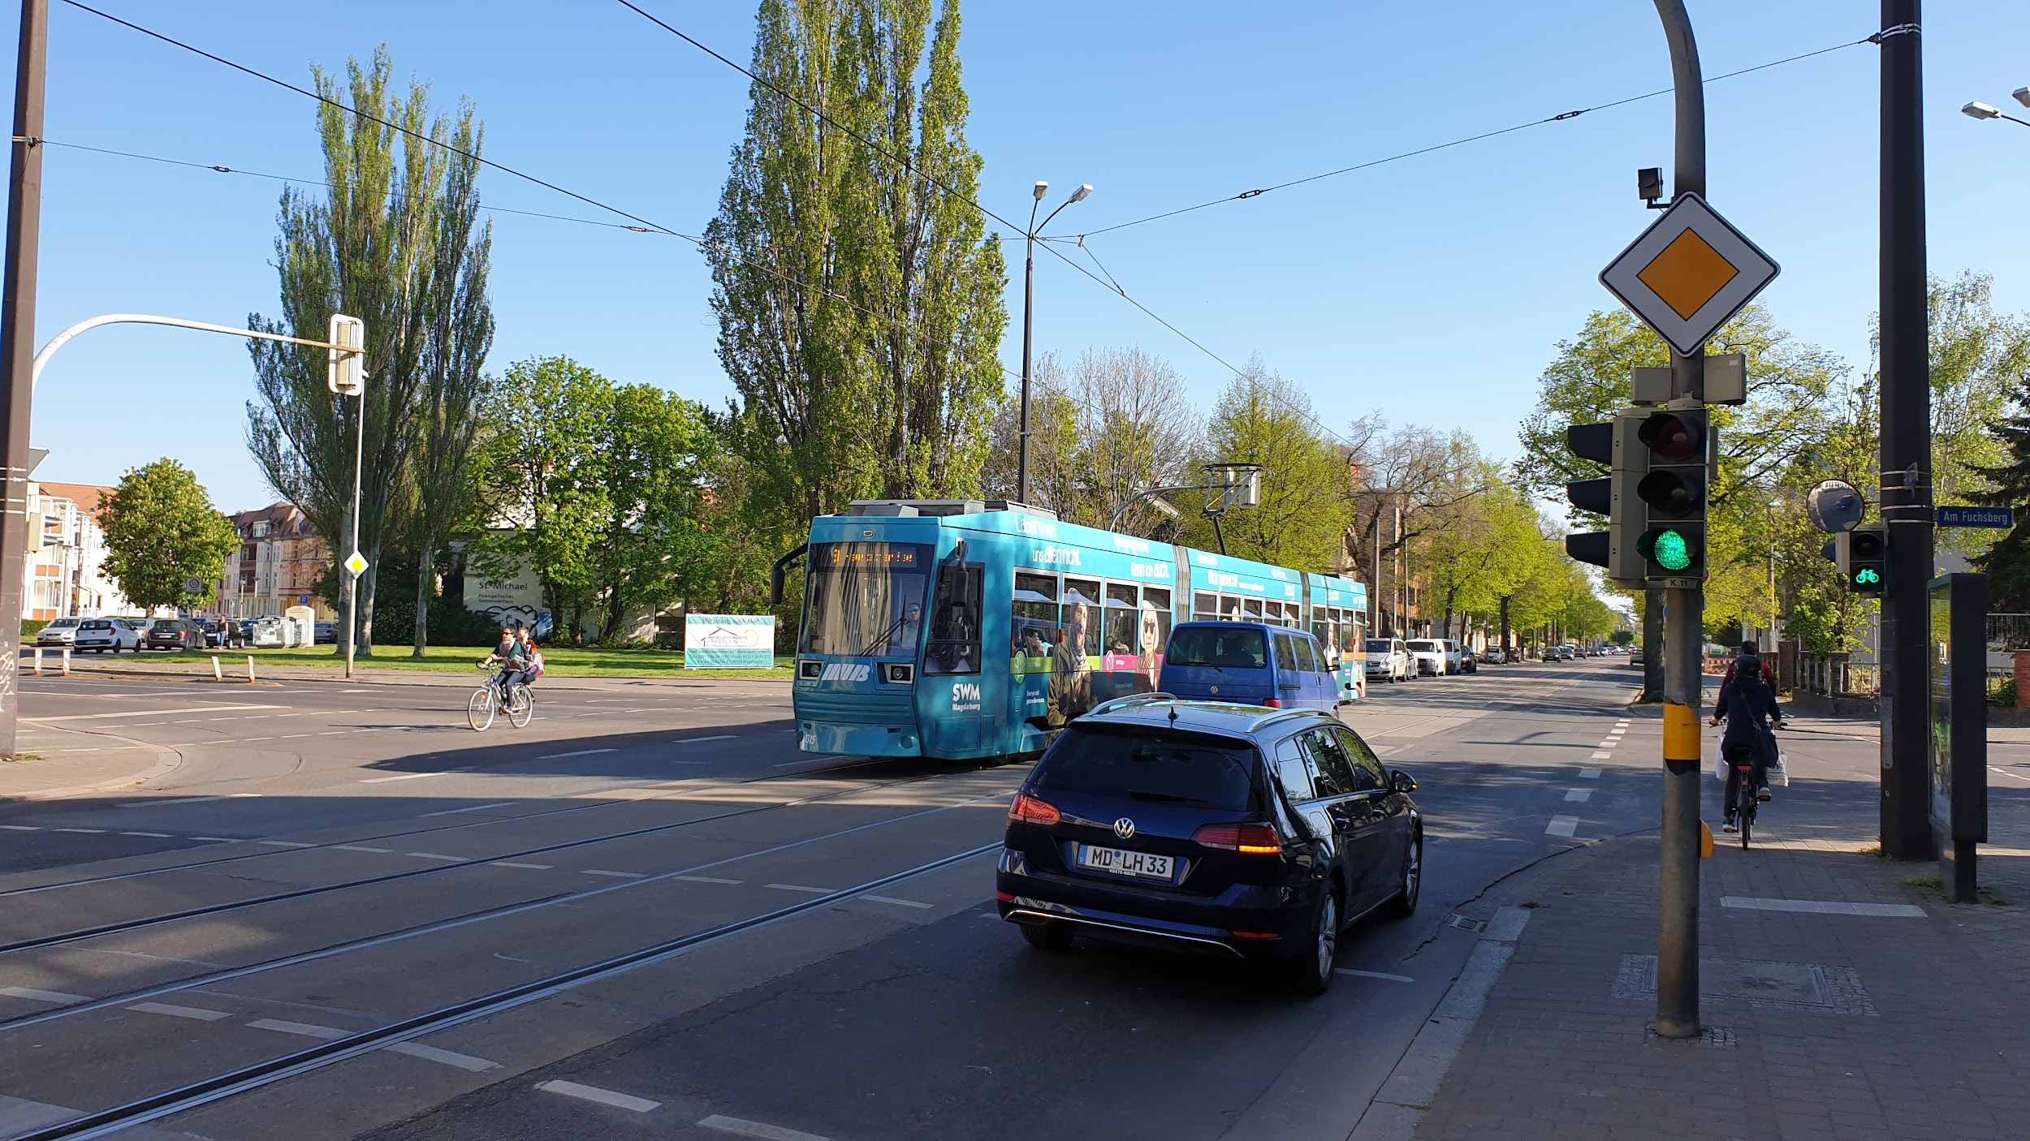
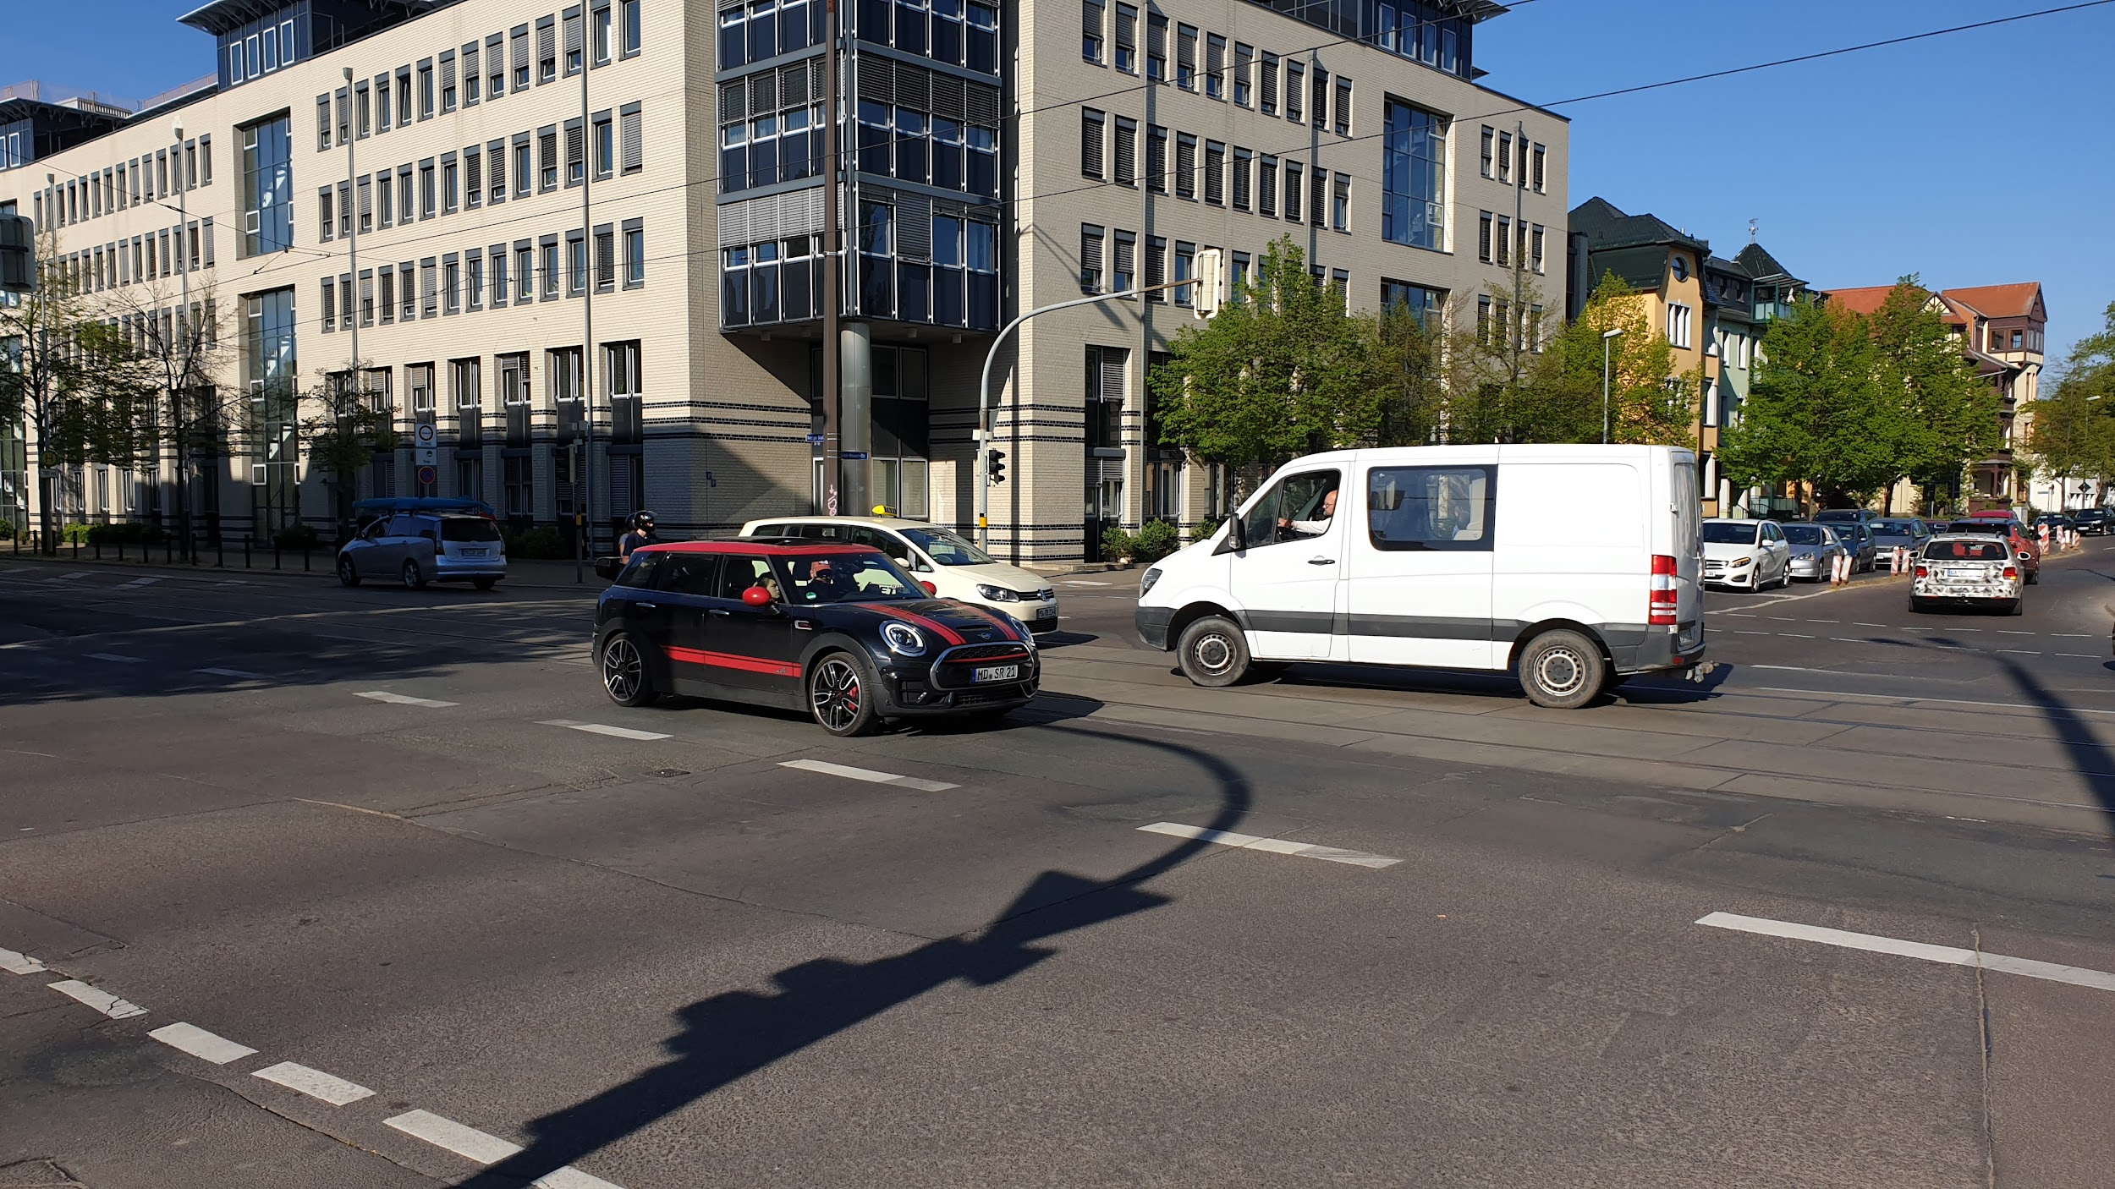
Simulation Project - Team D
Milestone #1 - Team
04
Tram line in Leipziger str.
05
Cars from all roads and directions can turn both right and left, as well as proceed forward.

Slide 9
Necessary data for the analysis
01
02
03
04
05
06
Simulation Project - Team D
Milestone #1 - Team
Vehicle data
Traffic light data
Public transp. data
Interarrival times
Direction
Alternation between cars and trams
Duration (does it vary during the day?)
Impact of pedestrians pressing the button
Is it off during the night?
Timetable of trams and buses
Delays
Pedestrian data
Safety data
Challenge!
Interarrival times
Accident statistics (frequency, magnitude)
Hard to estimate safety as a result of sim. parameters. Use indirect data such as avg. speed of cars, throughput, among others.

Slide 10
Experiments
01
04
02
05
03
06
Simulation Project - Team D
Milestone #1 - Team
Vary traffic light sequence to search for optimal waiting times and traffic flow.
Allow car traffic on the blocked tram line in Leipziger Str.
Vary traffic light duration.
Create a roundabout for cars and remove traffic lights.
Include a free lane to turn right for cars from Leipziger str. to Erich-Weinert str.
Bridge for cars going straight in Erich-Weinert-Straße / Am Fuchsberg

Slide 11
03
The goals
Simulation Project - Team D
Milestone #1 - Team
Our performance and quality criteria

Slide 12
Goals
TEAM GOAL
PROJECT GOALS
PROJECT GOALS
Simulation Project - Team D
Milestone #1 - Team
To establish a cooperative environment where each team member contributes with meaningful insights and learns from the others.
To complete each milestone and the overall project within schedule and budget.
To deliver a high-quality simulation that offers valuable insight on how to improve safety and reduce congestion.

Slide 13
04
The evaluation
Simulation Project - Team D
Milestone #1 - Team
Our team and project goals

Slide 14
4 main areas
01
02
03
04
Person responsible: Chandan Radhakrishna
Simulation Project - Team D
Milestone #1 - Team
Individual performance: Group participation
Individual performance: Deadlines and timeliness
Individual performance: Quality of tasks
Project quality: model related metrics

Slide 15
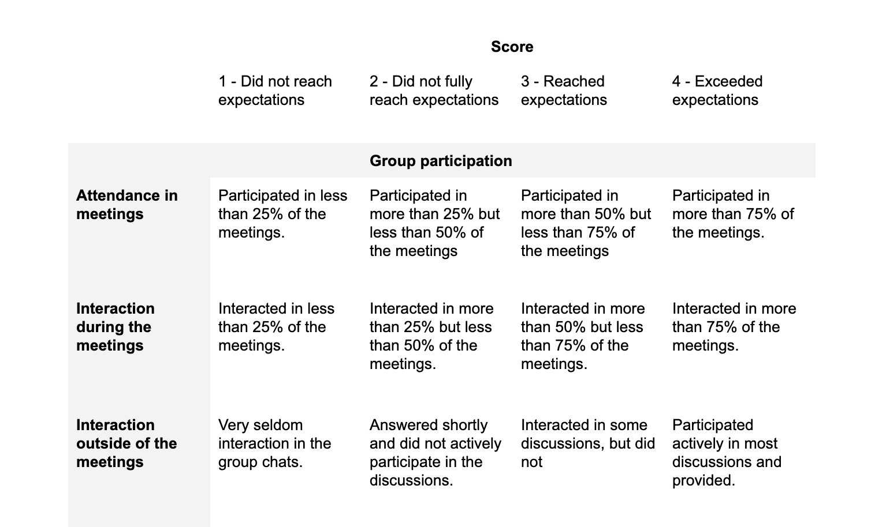
Evaluation rubric
Simulation Project - Team D
Milestone #1 - Team

Slide 16
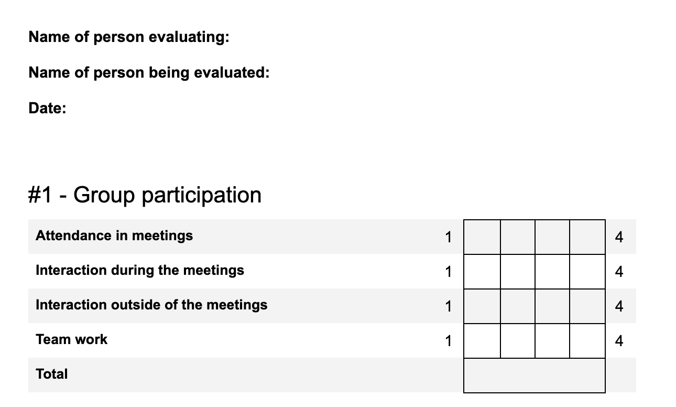
Evaluation sheet
Simulation Project - Team D
Milestone #1 - Team

Slide 17
05
Current costs
Simulation Project - Team D
Milestone #1 - Team

Slide 18
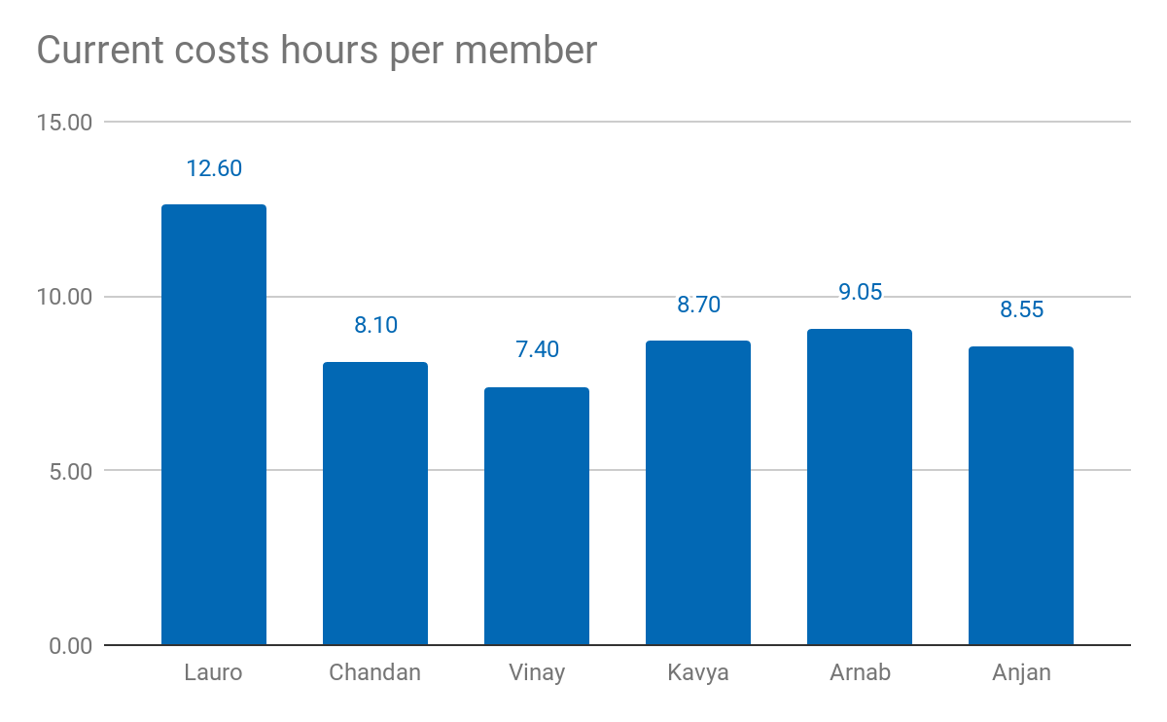
Current costs as % of total cost: 9.07%
Current costs: 5.440,00 €
Simulation Project - Team D
Milestone #1 - Team

Slide 19
Tasks completed so far
✓
✓
✓
✓
✓
✓
✓
✓
Simulation Project - Team D
Milestone #1 - Team
Define team structure.
Define team’s visual identity.
Define experiments and necessary data.
Define evaluation criteria.
Create cost trackers.
Visit and inspect the node.
Draft work packets and assignments.
Start conceptual model.

Slide 20
06
Thank you!
Simulation Project - Team D
Milestone #1 - Team
Questions?

